Slide 1
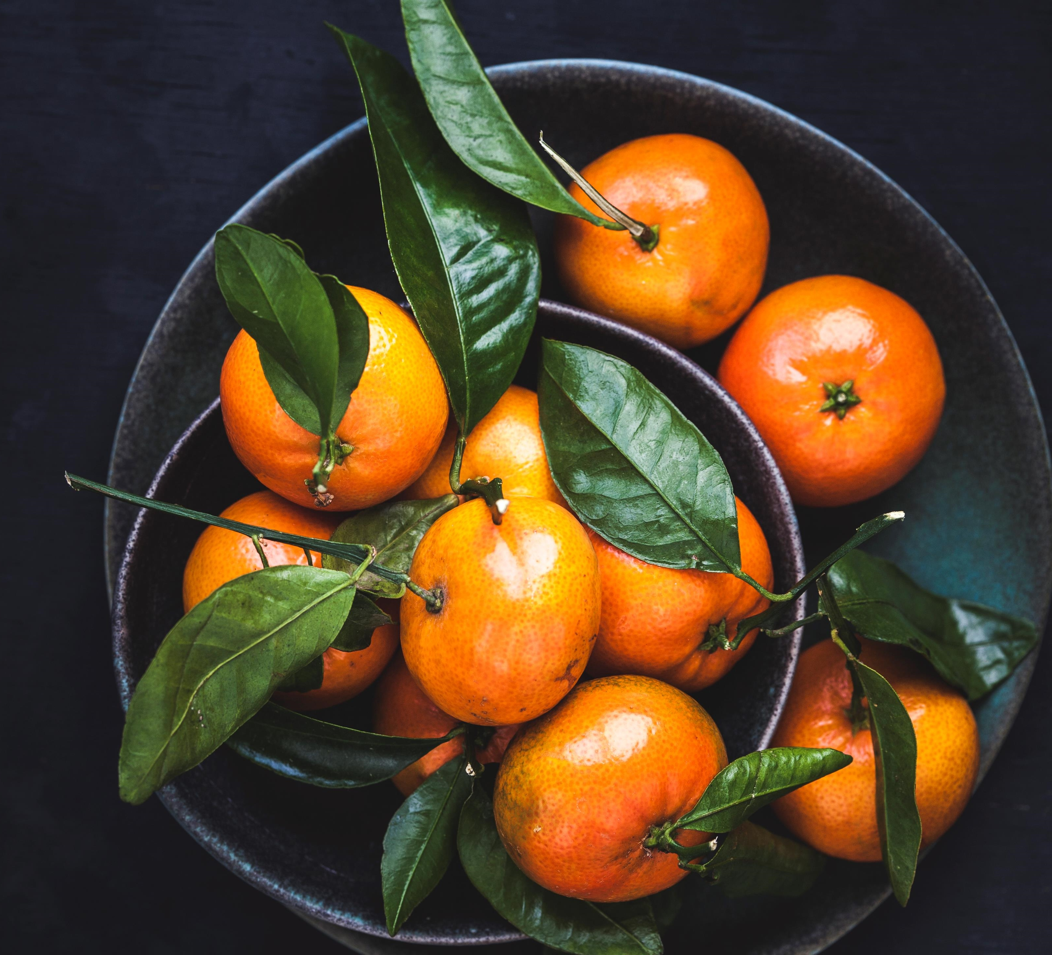
SWAP-IT Web-based barter system
SIT725
James NeMECEK, Julia Axelrod, Muhammad haroon, and bose alli
Deakin university, 2021 T3

Slide 2
Timeline
2022, January 1 - 10
We finished SRS and design approach in early January 2022.
2022, January 28
January 2022 – Sprint 1.
Things are shaping up!
2022, February
February 2022 – we will help to change the world, one item at a time! Expect completion of Sprint 2

Slide 3
Product perspective
The Bartering Application is a web application being developed in response to the increasing amount of waste in our communities, generated from people choosing to purchase new goods rather than recycle.
This online approach takes inspiration from platforms such as eBay and Facebook marketplace by allowing users to list items they wish to unload.
However, unlike majority of online marketplaces, this web application promotes recycling by allowing users to trade items for other items or items for services.

Slide 4

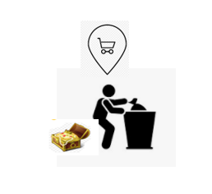
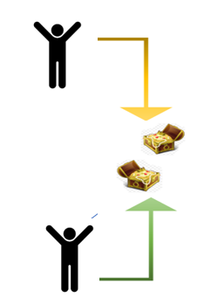
Using web application to reduce waste
Instead of THIS:
We want to facilitate THIS:

Slide 5
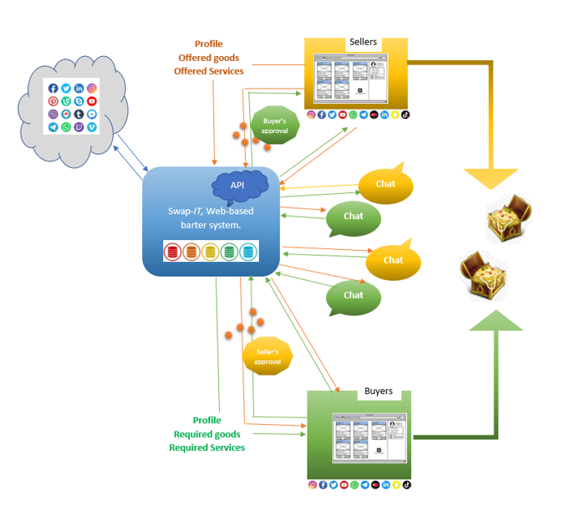
Communication is the key – we are building a server

Slide 6

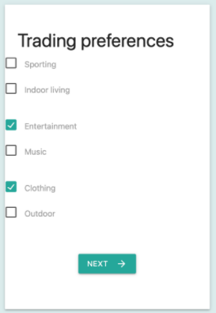
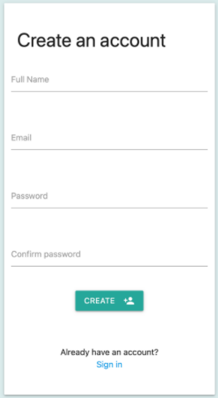
Tell us who you are, seller or buyer
James finished developing user login and profile.
You can register or log in with account or social media.
You can add your preferences and interests.

Slide 7
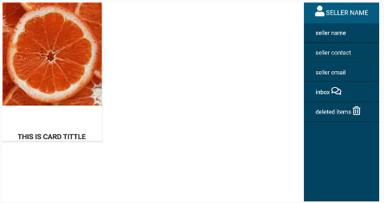
Muhammad has completed HTML page for seller, and it looks splendid!

Slide 8
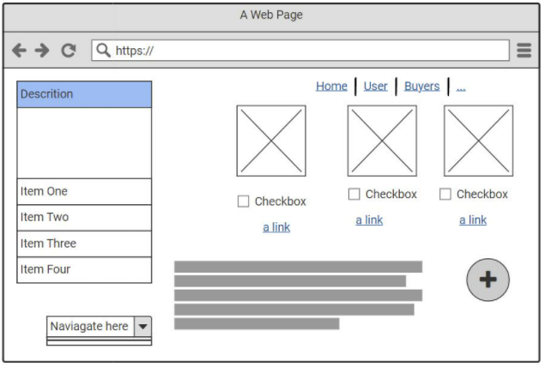
Bose is working to accommodate buyer's needs.
Buyer needs to be able to offer goods or services on their page as well as items they wish to acquire.

Slide 9
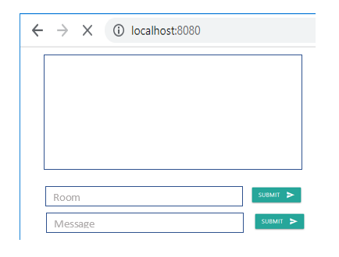
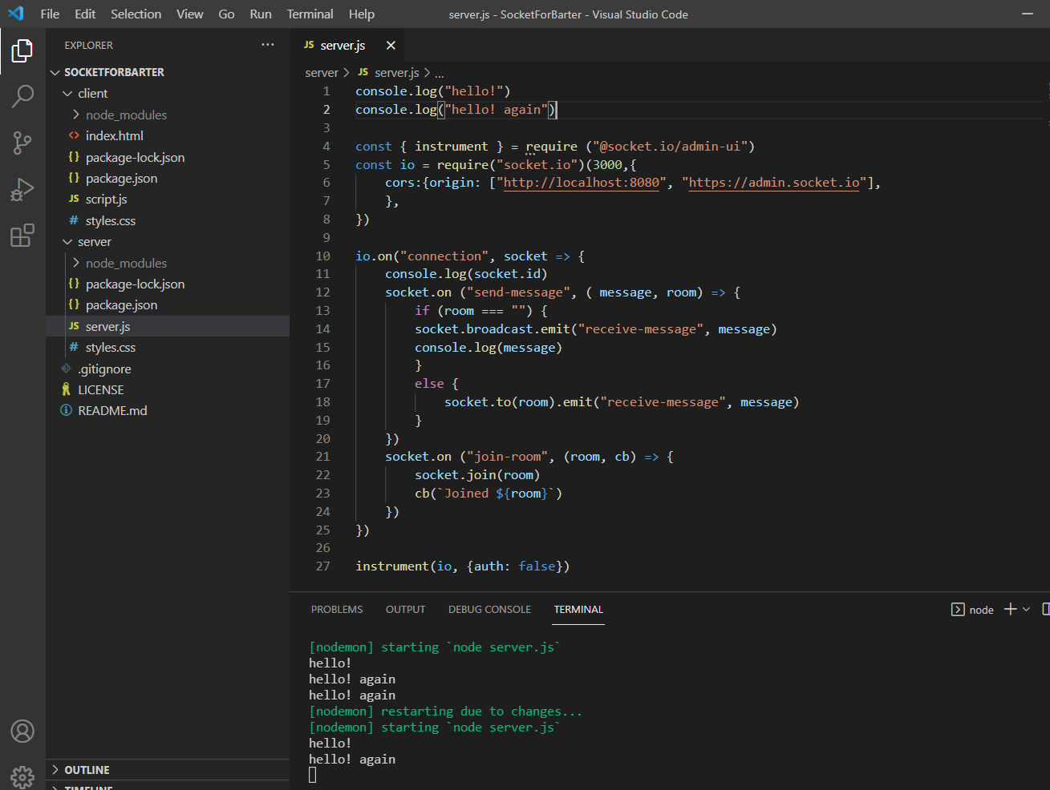
Communication is the key! Julia is working on chat code
Server is ready and listening on port 3000!
Anybody here??? Client scheduled for Sprint 2

Slide 10



Powered by
JavaScript
Mongo DB
Node JS
Materialize
MS Teams
Trello Board

Slide 11
Sprint 2
Develop backend including database for storing user records and their offers.
Provide search and match functionality, delisting of items and flagging them as sold.
Develop approvals and ratings system for buyers, sellers, goods and services.

